Slide 1
Topic IP Services
CCNA Routing and Switching
200-120 Examination
Jeng-Yueng Chen
Hsiuping University of Science and Technology

Slide 2
201
Which statement is correct regarding the operation of DHCP?
A DHCP client uses a ping to detect address conflicts.
A DHCP server uses a gratuitous ARP to detect DHCP clients.
A DHCP client uses a gratuitous ARP to detect a DHCP server.
If an address conflict is detected, the address is removed from the pool and an administrator must resolve the conflict.
If an address conflict is detected, the address is removed from the pool for an amount of time configurable by the administrator.
If an address conflict is detected, the address is removed from the pool and will not be reused until the server is rebooted.

Slide 3
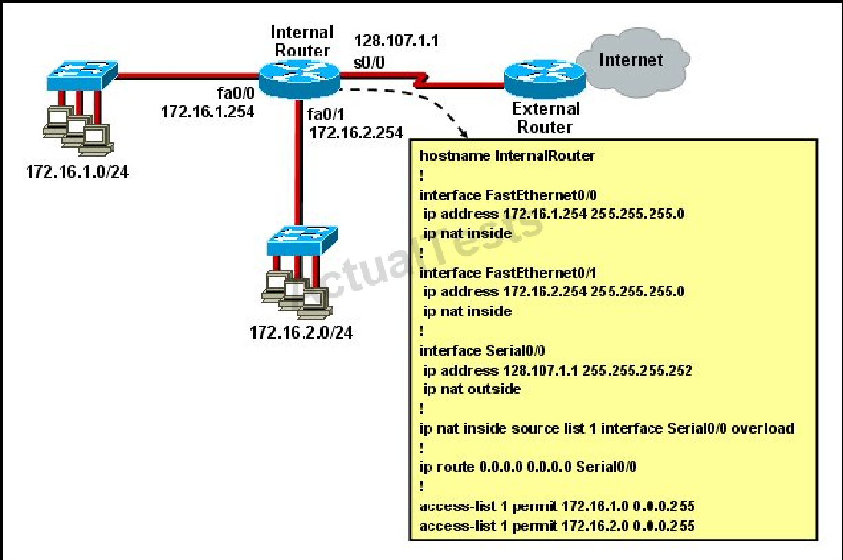
202
Refer to the exhibit. What statement is true of the configuration for this network?

Slide 4
202
The configuration that is shown provides inadequate outside address space for translation of the number of inside addresses that are supported.
Because of the addressing on interface FastEthernet0/1, the Serial0/0 interface address will not support the NAT configuration as shown.
The number 1 referred to in the ip nat inside source command references access-list number 1.
ExternalRouter must be configured with static routes to networks 172.16.1.0/24 and 172.16.2.0/24.

Slide 5
203
Which statement describes the process of dynamically assigning IP addresses by the DHCP server?
Addresses are allocated after a negotiation between the server and the host to determine the length of the agreement.
Addresses are permanently assigned so that the hosts uses the same address at all times.
Addresses are assigned for a fixed period of time, at the end of the period, a new request for an address must be made.
Addresses are leased to hosts, which periodically contact the DHCP server to renew the lease.

Slide 6
204
What are two benefits of using NAT? (Choose two.)
NAT facilitates end-to-end communication when IPsec is enabled.
NAT eliminates the need to re-address all hosts that require external access.
NAT conserves addresses through host MAC-level multiplexing.
Dynamic NAT facilitates connections from the outside of the network.
NAT accelerates the routing process because no modifications are made on the packets.
NAT protects network security because private networks are not advertised.

Slide 7
205
On which options are standard access lists based?
destination address and wildcard mask
destination address and subnet mask
source address and subnet mask
source address and wildcard mask

Slide 8
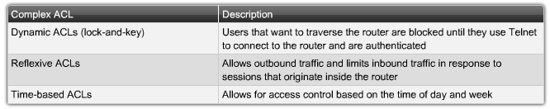
Types of Complex ACLs

Slide 9
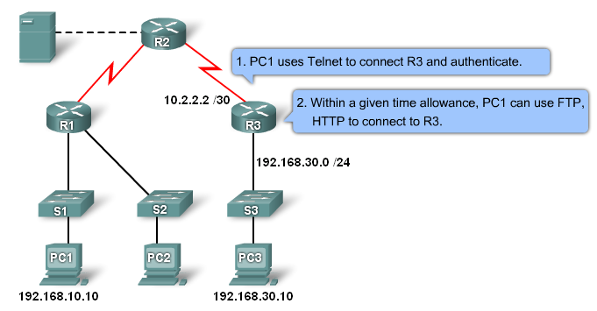
Dynamic ACLs

Slide 10
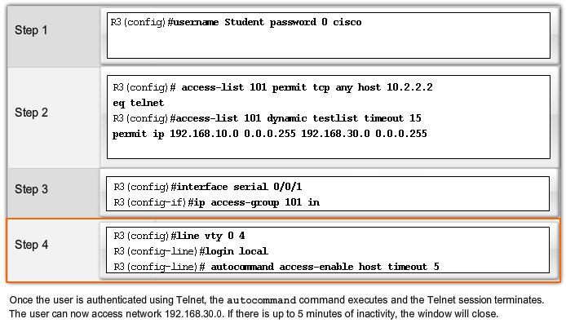
Dynamic ACLs

Slide 11
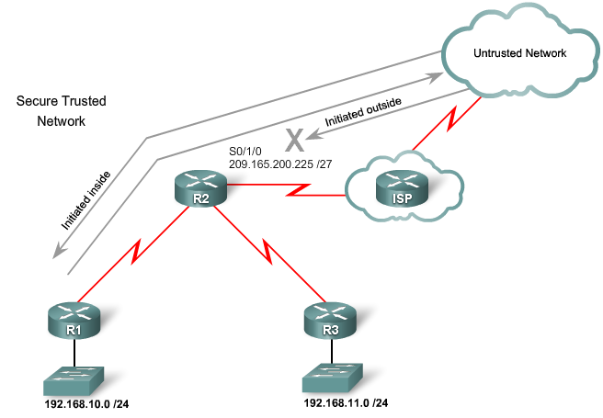
Reflexive ACLs

Slide 12
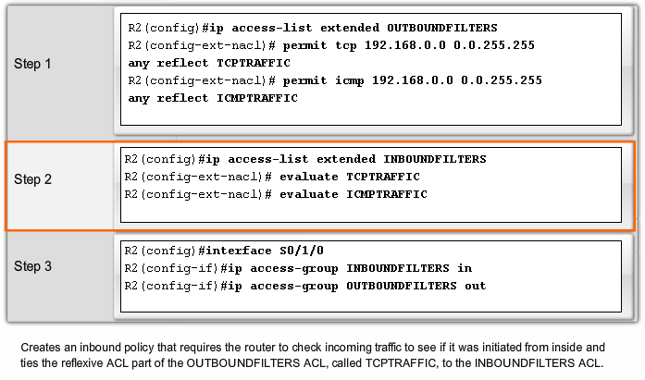
Reflexive ACL Example

Slide 13
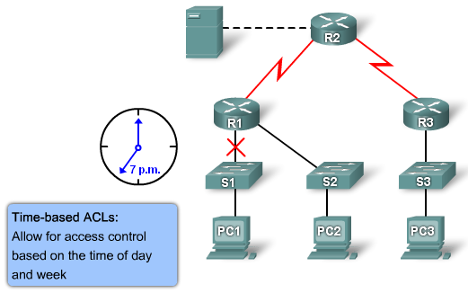
Time-based ACLs

Slide 14
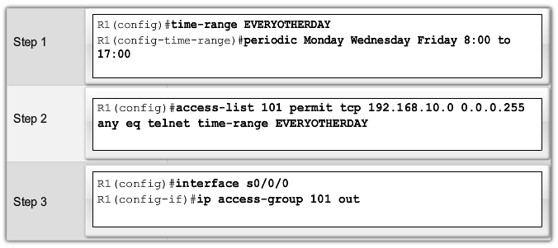
Time-based ACLs

Slide 15
206
A network engineer wants to allow a temporary entry for a remote user with a specific username and password so that the user can access the entire network over the Internet. Which ACL can be used?
standard
extended
dynamic
reflexive

Slide 16
207
How does a DHCP server dynamically assign IP addresses to hosts?
Addresses are permanently assigned so that the host uses the same address at all times.
Addresses are assigned for a fixed period of time. At the end of the period, a new request for an address must be made, and another address is then assigned.
Addresses are leased to hosts. A host will usually keep the same address by periodically contacting the DHCP server to renew the lease.
Addresses are allocated after a negotiation between the server and the host to determine the length of the agreement.

Slide 17
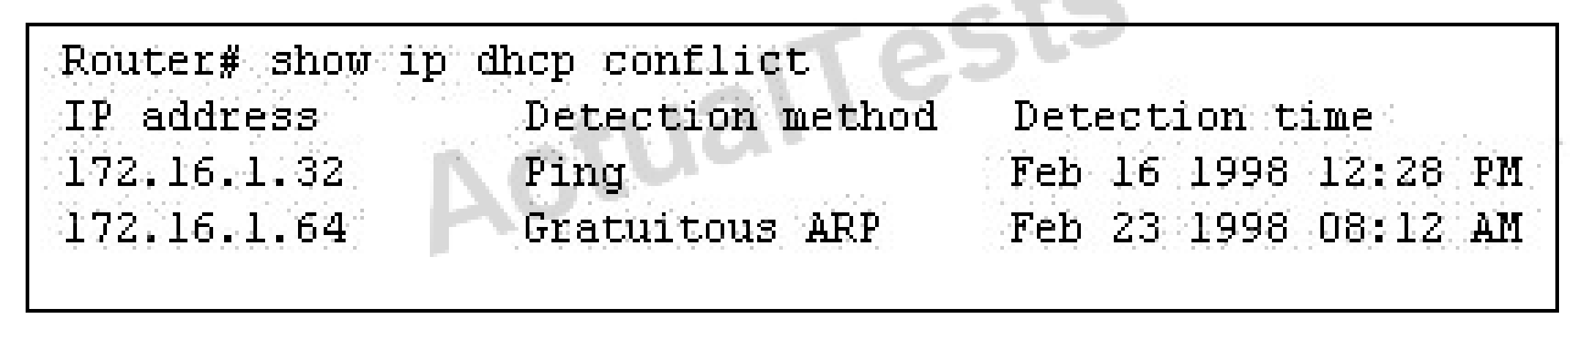
208
Refer to the exhibit. Which rule does the DHCP server use when there is an IP address conflict?
The address is removed from the pool until the conflict is resolved.
The address remains in the pool until the conflict is resolved.
Only the IP detected by Gratuitous ARP is removed from the pool.
Only the IP detected by Ping is removed from the pool.
The IP will be shown, even after the conflict is resolved.

Slide 18
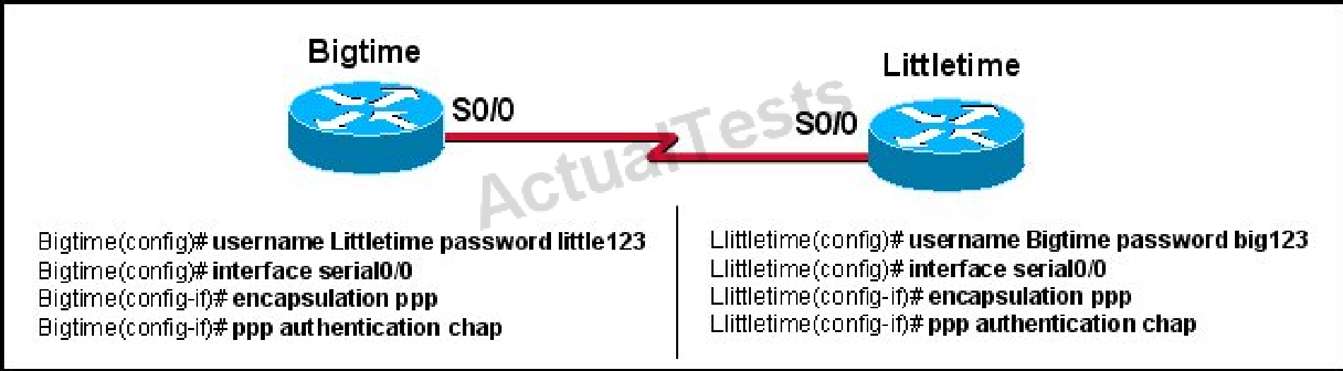
209
Refer to the exhibit. The Bigtime router is unable to authenticate to the Littletime router. What is the cause of the problem?
The usernames are incorrectly configured on the two routers.
The passwords do not match on the two routers.
CHAP authentication cannot be used on a serial interface.
The routers cannot be connected from interface S0/0 to interface S0/0.
With CHAP authentication, one router must authenticate to another router. The routers cannot be configured to authenticate to each other.

Slide 19
210
Which two tasks does the Dynamic Host Configuration Protocol perform? (Choose two.)
Set the IP gateway to be used by the network.
Perform host discovery used DHCPDISCOVER message.
Configure IP address parameters from DHCP server to a host.
Provide an easy management of layer 3 devices.
Monitor IP performance using the DHCP server.
Assign and renew IP address from the default pool.

Slide 20
211
When a DHCP server is configured, which two IP addresses should never be assignable to hosts? (Choose two.)
network or subnetwork IP address
broadcast address on the network
IP address leased to the LAN
IP address used by the interfaces
manually assigned address to the clients
designated IP address to the DHCP server

Slide 21
212
Which two statements about static NAT translations are true? (Choose two.)
They allow connections to be initiated from the outside.
They require no inside or outside interface markings because addresses are statically defined.
They are always present in the NAT table.
They can be configured with access lists, to allow two or more connections to be initiated from the outside.

Slide 22
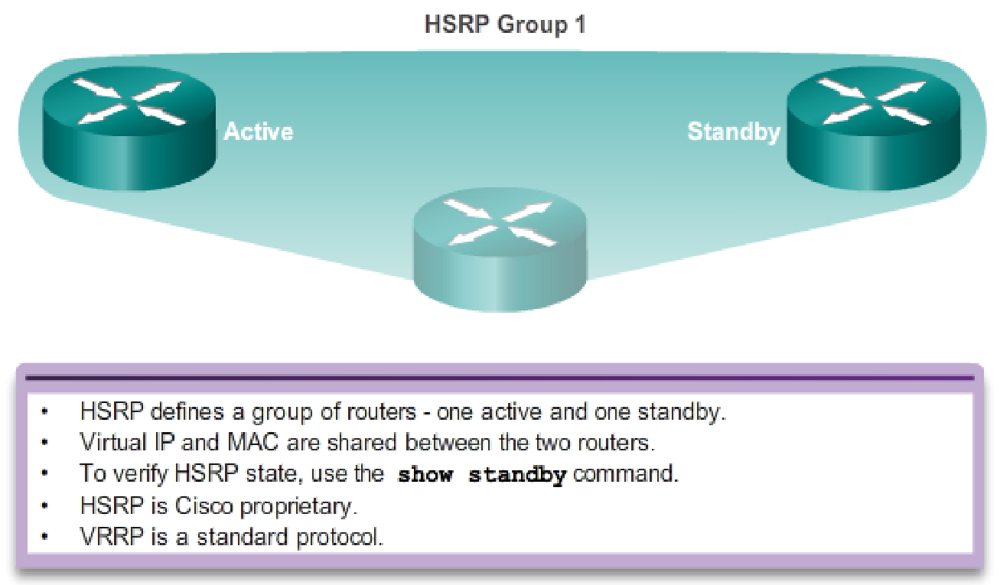
First Hop Redundancy Protocols

Slide 23
213
What is a valid HSRP virtual MAC address?
0000.5E00.01A3
0007.B400.AE01
0000.0C07.AC15
0007.5E00.B301
HSRP Virtual MAC
HSRPv1 0000.0C07.ACxx
HSRPv2 0000.0C9F.Fxxx

Slide 24
214
In GLBP, which router will respond to client ARP requests?
The active virtual gateway will reply with one of four possible virtual MAC addresses.
All GLBP member routers will reply in round-robin fashion.
The active virtual gateway will reply with its own hardware MAC address.
The GLBP member routers will reply with one of four possible burned in hardware addresses.

Slide 25
215
Which statement describes VRRP object tracking?
It monitors traffic flow and link utilization.
It ensures the best VRRP router is the virtual router master for the group.
It causes traffic to dynamically move to higher bandwidth links.
It thwarts man-in-the-middle attacks.

Slide 26
216
What are three benefits of GLBP? (Choose three.)
GLBP supports up to eight virtual forwarders per GLBP group.
GLBP supports clear text and MD5 password authentication between GLBP group members.
GLBP is an open source standardized protocol that can be used with multiple vendors.
GLBP supports up to 1024 virtual routers.
GLBP can load share traffic across a maximum of four routers.
GLBP elects two AVGs and two standby AVGs for redundancy.
Notes:
Members of a GLBP group elect one gateway to be the active virtual gateway (AVG) for that group. Other group members provide backup for the AVG in the event that the AVG becomes unavailable. The AVG assigns a virtual MAC address to each member of the GLBP group. Each gateway assumes responsibility for forwarding packets sent to the virtual MAC address assigned to it by the AVG. These gateways are known as active virtual forwarders (AVFs) for their virtual MAC address.
The AVG is responsible for answering Address Resolution Protocol (ARP) requests for the virtual IP address. Load sharing is achieved by the AVG replying to the ARP requests with different virtual MAC addresses.
GLBP supports up to 1024 virtual routers (GLBP groups) on each physical interface of a router, and up to 4 virtual forwarders per group.

Slide 27
217
Which three statements about HSRP operation are true? (Choose three.)
The virtual IP address and virtual MAC address are active on the HSRP Master router.
The HSRP default timers are a 3 second hello interval and a 10 second dead interval.
HSRP supports only clear-text authentication.
The HSRP virtual IP address must be on a different subnet than the routers' interfaces on the same LAN.
The HSRP virtual IP address must be the same as one of the router's interface addresses on the LAN.
HSRP supports up to 255 groups per interface, enabling an administrative form of load balancing.
Notes:
Each router only uses three timers in HSRP. The timers time hello messages. The HSRP converges, when a failure occurs, depend on how the HSRP hello and hold timers are configured. By default, these timers are set to 3 and 10 seconds, respectively, which means that a hello packet is sent between the HSRP standby group devices every 3 seconds, and the standby device becomes active when a hello packet has not been received for 10 seconds. You can lower these timer settings to speed up the failover or preemption, but, to avoid increased CPU usage and unnecessary standby state flapping, do not set the hello timer below one (1) second or the hold timer below 4 seconds. Note that, if you use the HSRP tracking mechanism and the tracked link fails, the failover or preemption occurs immediately, regardless of the hello and hold timers. When a timer expires, the router transitions to a new HSRP state. The timers can be changed with this command: standby [group-number] timers hellotime holdtime .
HSRP MD5 authentication

Slide 28
SNMP
SNMP is an application layer protocol that provides a message format for communication between what are termed managers and agents
Components include
SNMP manager
SNMP agent
Management Information Base

Slide 29
SNMP Messages
Get
Set
Trap - unreliable
Trap (SNMPv3 uses ACK) - reliable

Slide 30
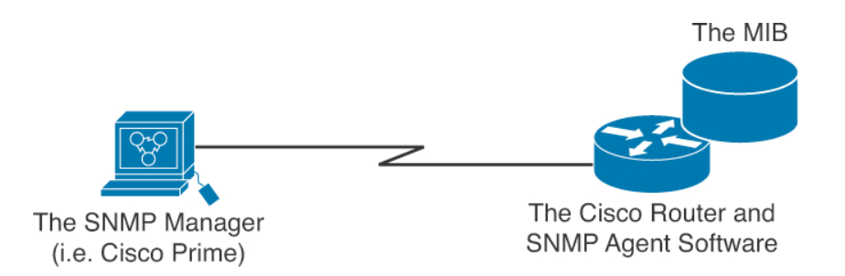
Elements of Simple Network Management Protocol

Slide 31
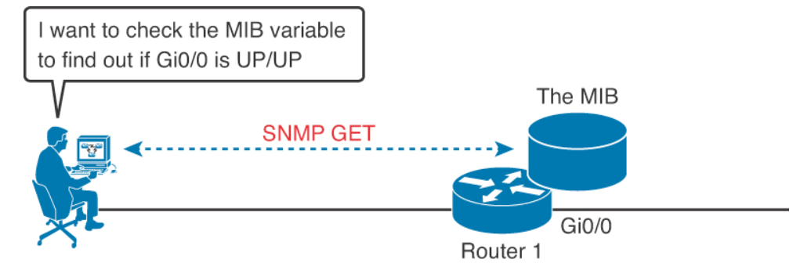
SNMP in Use for Monitoring the Network

Slide 32
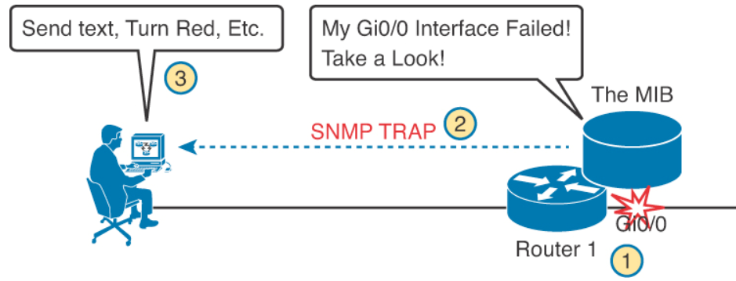
SNMP in Use for Monitoring the Network

Slide 33
The Management Information Base (MIB)
MIB defines each variable as an object ID (OID)
Organizes the into a hierarchy of OIDs, usually shown as a tree
MIB for any device includes some branches of the tree with variables common to many networking devices and branches with variables specific to that device.
Networking equipment vendors like Cisco can define their own private branches of the tree

Slide 34
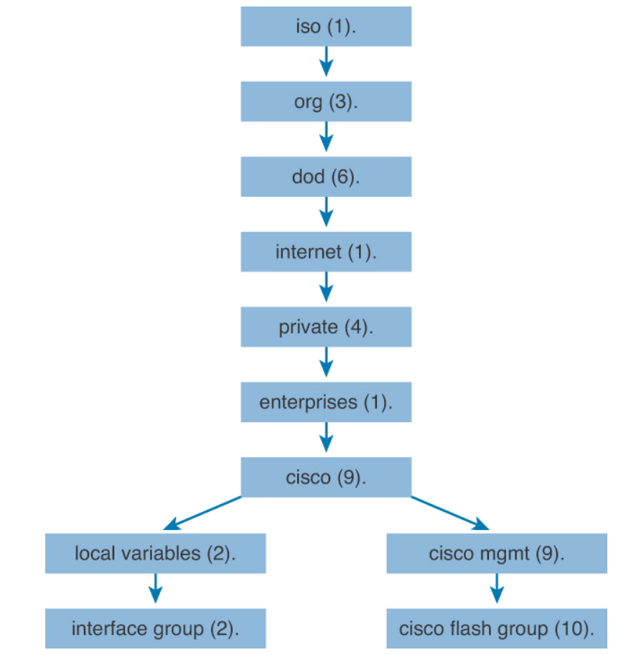
MIB tree

Slide 35
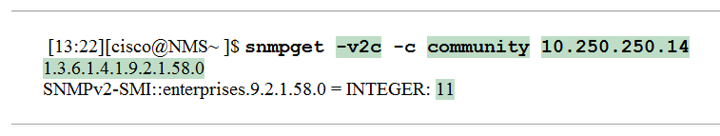
Obtaining MIB value with snmpget
-v2c The version on SNMP in use
-c community The SNMP password, called a community string
10.250.250.14 The IP address of the monitored device
1.3.6.1.4.1.9.2.1.58.0 The numeric object identifier (OID) of the MIB variable

Slide 36
Configuring SNMPv2
There are two types of community strings in SNMP Version 2c:
Read-only (RO): Provides access to the MIB variables, but does not allow these variables to changed, only read. Because security is so weak in Version 2c, many organizations only use SNMP in this read-only mode.
Read-write (RW): Provides read and write access to all objects in the MIB.

Slide 37
Configuring SNMP Version 2c for Read-Only Access
R1(config)# ip access-list standard ACL_PROTECTSNMP
R1(config-std-nacl)# permit host 10.10.10.101
R1(config-std-nacl)# exit
R1(config)# snmp-server community V011eyB@11!!! RO ACL_PROTECTSNMP
R1(config)# snmp-server location Tampa
R1(config)# snmp-server contact Anthony Sequeira
R1(config)# end
R1#

Slide 38
Configuring SNMP Version 2c for Read and Write Access
R2(config)# ip access-list standard ACL_PROTECTSNMP
R2(config-std-nacl)# permit host 10.20.20.201
R2(config-std-nacl)# exit
R2(config)# snmp-server community T3nn1sB@ll RW ACL_PROTECTSNMP
R2(config)# snmp-server location New York
R2(config)# snmp-server contact John Sequeira
R2(config)# end
R2#

Slide 39
SNMPv3
Message integrity: This helps ensure that a packet has not been tampered with in transit
Authentication: This helps ensure that the packet came from a known and trusted source
Encryption: This helps to ensure that information cannot be read if the data is captured in transit

Slide 40
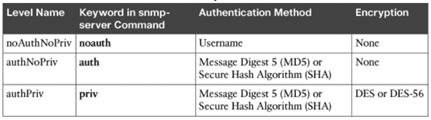
Possible Security modes of SNMPv3

Slide 41
Syslog
Syslog permits various Cisco devices (and some other non-Cisco devices) to send their system messages across the network to syslog servers
You can even build a special out-of-band (OOB) network for this purpose
There are many different Syslog server software packages for Windows and UNIX

Slide 42
Popular destinations for syslog messages
The logging buffer (RAM inside the router or switch)
The console line
The terminal lines
A syslog server

Slide 43
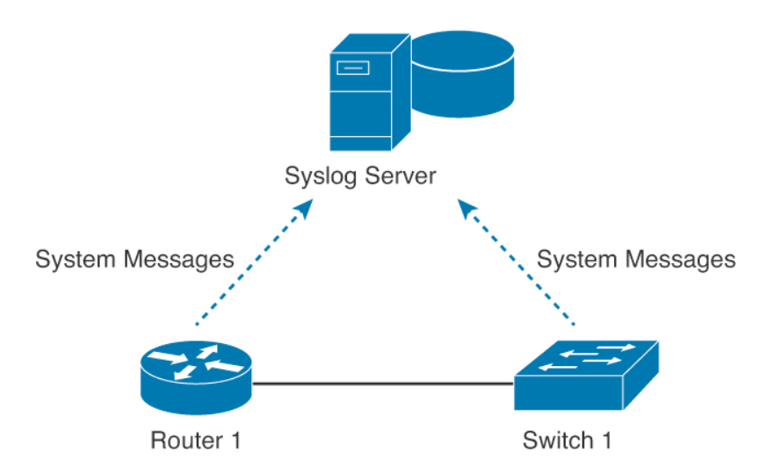
Syslogging in the Network

Slide 44

System Message Format
A timestamp: *Dec 18 17:10:15.079
The facility on the router that generated the message: %LINEPROTO
The severity level: 5
A mnemonic for the message: UPDOWN
The description of the message: Line protocol on Interface FastEthernet0/0, changed state to down

Slide 45
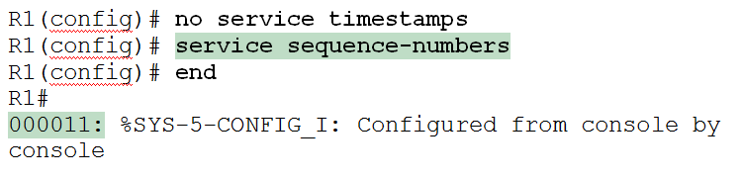
Modifying System Messages

Slide 46
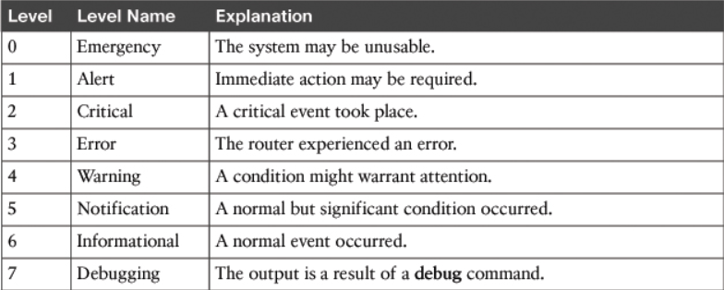
System Message Severity Levels

Slide 47
Configuring and Verifying Syslog
R1(config)#logging 192.168.1.101
R1(config)#logging trap 4
By default, Cisco routers and switches send log messages for all severity levels to the console. On some IOS versions, the device also buffers those log messages by default
R1(config)# logging console
R1(config)# logging buffered
R1# show logging

Slide 48
218
Which three statements about Syslog utilization are true? (Choose three.)
Utilizing Syslog improves network performance.
The Syslog server automatically notifies the network administrator of network problems.
A Syslog server provides the storage space necessary to store log files without using router disk space.
There are more Syslog messages available within Cisco IOS than there are comparable SNMP trap messages.
Enabling Syslog on a router automatically enables NTP for accurate time stamping.
A Syslog server helps in aggregation of logs and alerts.

Slide 49
219
A network administrator enters the following command on a router: logging trap 3. What are three message types that will be sent to the Syslog server? (Choose three.)
informational
emergency
warning
critical
debug
error
Level Keyword | Level | Description
emergencies | 0 | System unstable
alerts | 1 | Immediate action needed
critical | 2 | Critical conditions
errors | 3 | Error conditions
warnings | 4 | Warning conditions
notifications | 5 | Normal but significant condition
informational | 6 | Informational messages only
debugging | 7 | Debugging messages
logging trap level
(Limit messages logged to the syslog servers.)

Slide 50
220
What is the default Syslog facility level?
local4
local5
local6
local7
Level Keyword | Level | Description
emergencies | 0 | System unstable
alerts | 1 | Immediate action needed
critical | 2 | Critical conditions
errors | 3 | Error conditions
warnings | 4 | Warning conditions
notifications | 5 | Normal but significant condition
informational | 6 | Informational messages only
debugging | 7 | Debugging messages

Slide 51
221
What command instructs the device to timestamp Syslog debug messages in milliseconds?
service timestamps log datetime localtime
service timestamps debug datetime msec
service timestamps debug datetime localtime
service timestamps log datetime msec

Slide 52
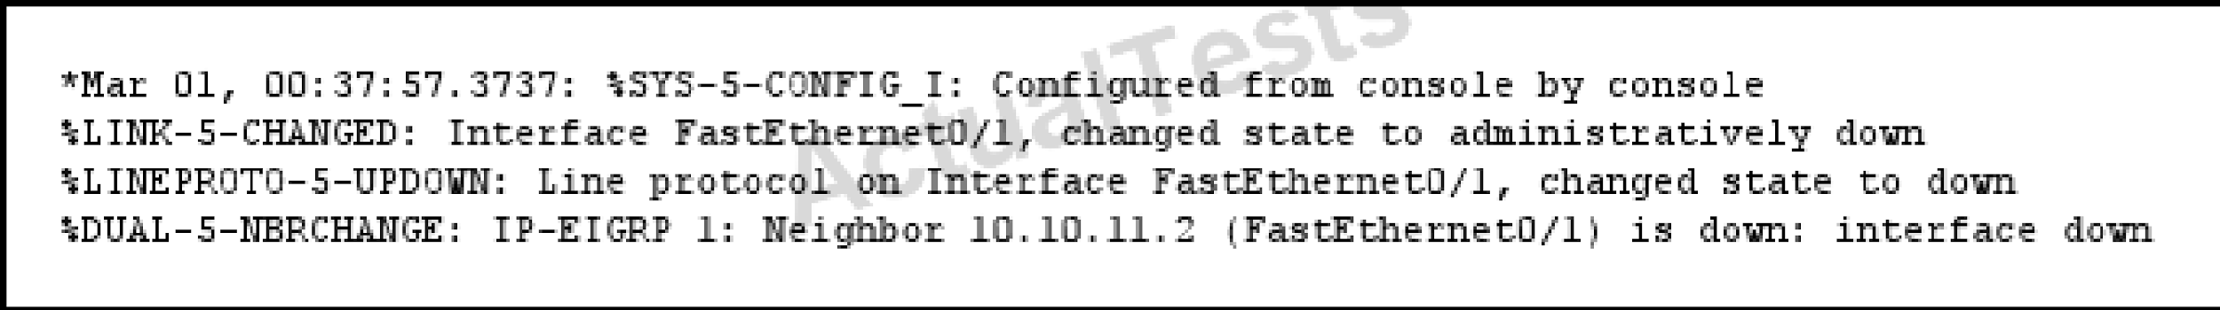
222
Refer to the exhibit. What is the cause of the Syslog output messages?
The EIGRP neighbor on Fa0/1 went down due to a failed link.
The EIGRP neighbor connected to Fa0/1 is participating in a different EIGRP process, causing the adjacency to go down.
A shut command was executed on interface Fa0/1, causing the EIGRP adjacency to go down.
Interface Fa0/1 has become error disabled, causing the EIGRP adjacency to go down.

Slide 53
223
What are three components that comprise the SNMP framework? (Choose three.)
MIB
agent
set
AES
supervisor
manager

Slide 54
224
What levels will be trapped if the administrator executes the command
router(config)# logging trap 4 (Choose four)
Emergency
Notice
Alert
Error
Warning
Level Keyword | Level | Description
emergencies | 0 | System unstable
alerts | 1 | Immediate action needed
critical | 2 | Critical conditions
errors | 3 | Error conditions
warnings | 4 | Warning conditions
notifications | 5 | Normal but significant condition
informational | 6 | Informational messages only
debugging | 7 | Debugging messages

Slide 55
225
What SNMP message alerts the manager to a condition on the network?
response
get
trap
capture

Slide 56
226
What authentication type is used by SNMPv2?
HMAC-MD5
HMAC-SHA
CBC-DES
community strings

Slide 57
227
Which three statements about the features of SNMPv2 and SNMPv3 are true? (Choose three.)
SNMPv3 enhanced SNMPv2 security features.
SNMPv3 added the Inform protocol message to SNMP.
SNMPv2 added the Inform protocol message to SNMP.
SNMPv3 added the GetBulk protocol messages to SNMP.
SNMPv2 added the GetBulk protocol message to SNMP.
SNMPv2 added the GetNext protocol message to SNMP.
Inform is a manager-to-manager notification
GetBulk operation merely requests a number of GETNEXT responses to be returned in a single packet

Slide 58
228
Which three are the components of SNMP? (Choose three)
MIB
SNMP Manager
SysLog Server
SNMP Agent
Set

Slide 59
229
What are the Popular destinations for syslog messages to be saved? (Choose three)
Flash
The logging buffer .RAM
The console terminal
Other terminals
Syslog server

Slide 60
230
Syslog was configured with a level 3 trap. Which 3 types of logs would be generated (choose four)
Emergencies
Alerts
Critical
Errors
Warnings
Level Keyword | Level | Description
emergencies | 0 | System unstable
alerts | 1 | Immediate action needed
critical | 2 | Critical conditions
errors | 3 | Error conditions
warnings | 4 | Warning conditions
notifications | 5 | Normal but significant condition
informational | 6 | Informational messages only
debugging | 7 | Debugging messages

Slide 61
231
What are the alert messages generated by SNMP agents called?
TRAP
INFORM
GET
SET
Notes:
TRAP is unacknowledged while INFORM is acknowledged

Slide 62
232
Which three features are added in SNMPv3 over SNMPv2?
Message Integrity
Compression
Authentication
Encryption
Error Detection

Slide 63
233
In a GLBP network, who is responsible for the ARP request?
AVF
AVG
Active Router
Standby Router

